Slide 1

Admiralsdon’tforget2240!

Slide 2
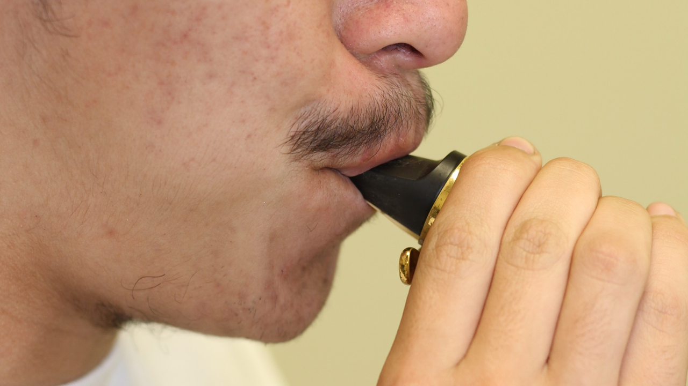
Corners in like a
drawstring bag

Slide 3
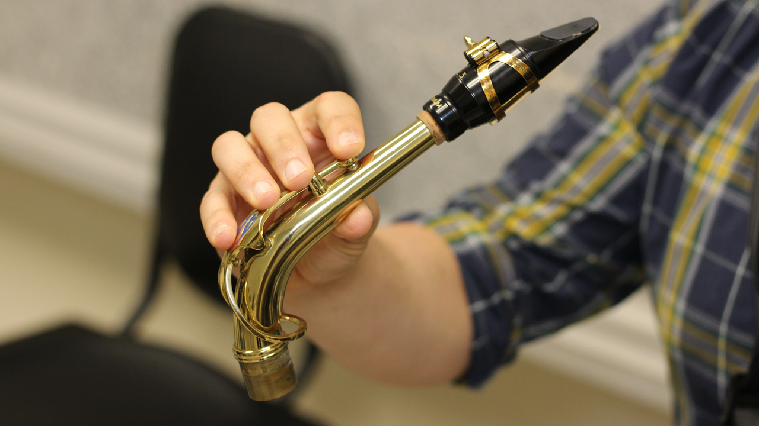
How to hold the neck

Slide 4
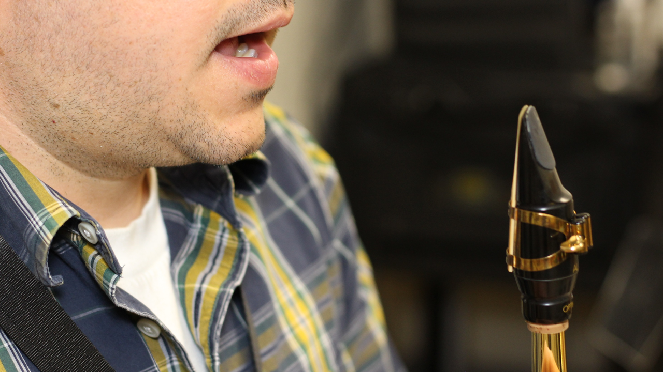
Open

Slide 5
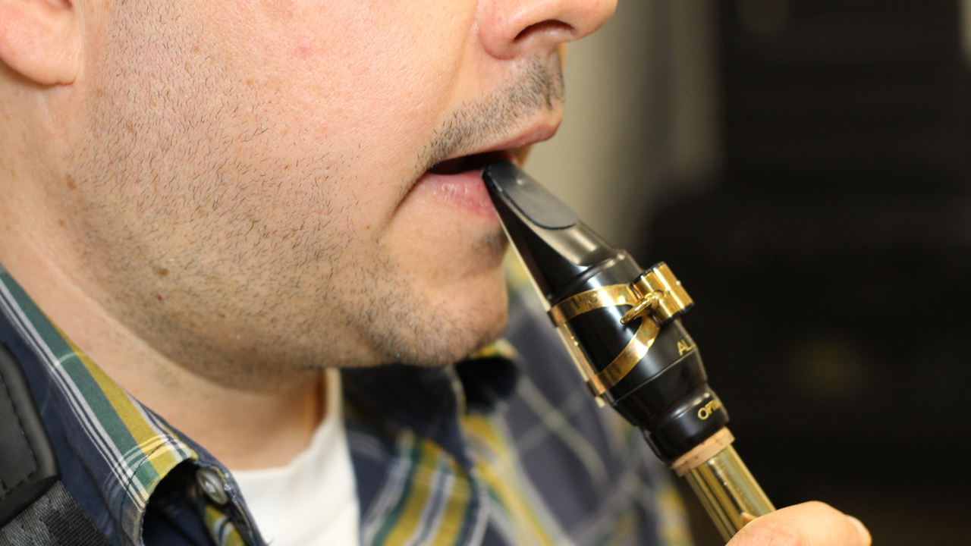
Insert

Slide 6
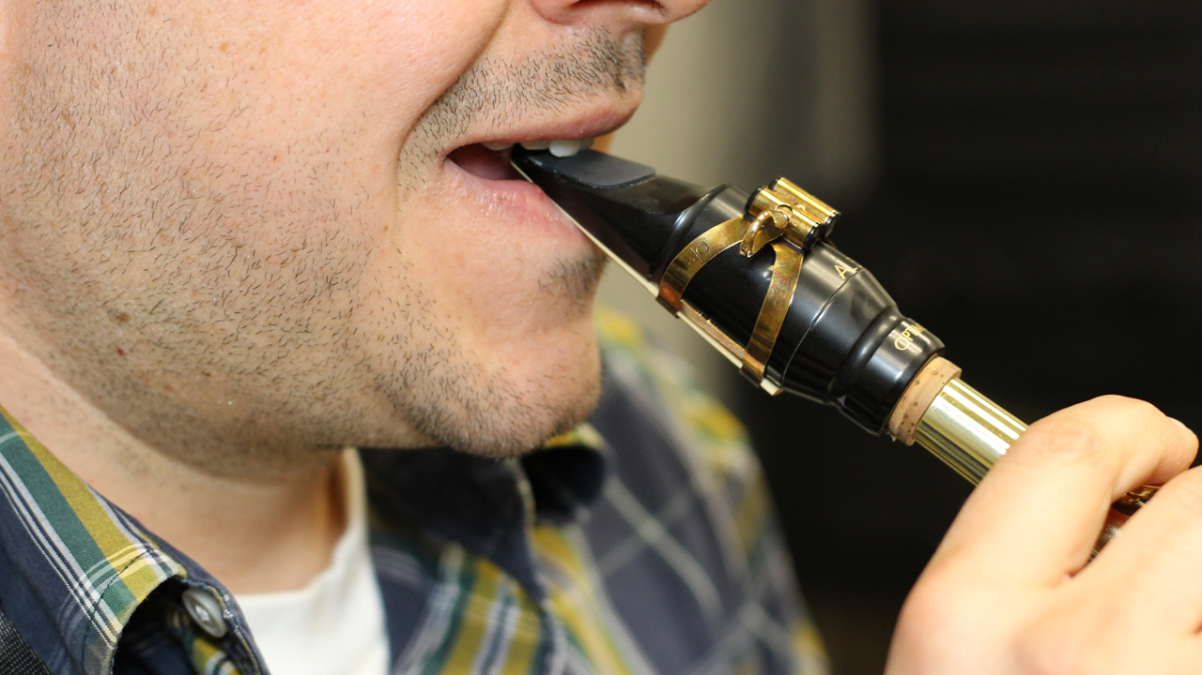
Top teeth on mouthpiece

Slide 7
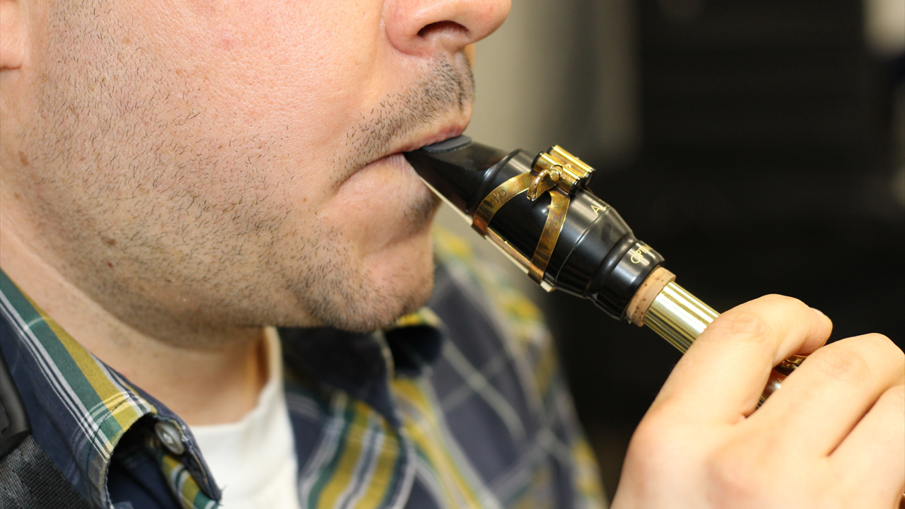
Blow

Slide 8
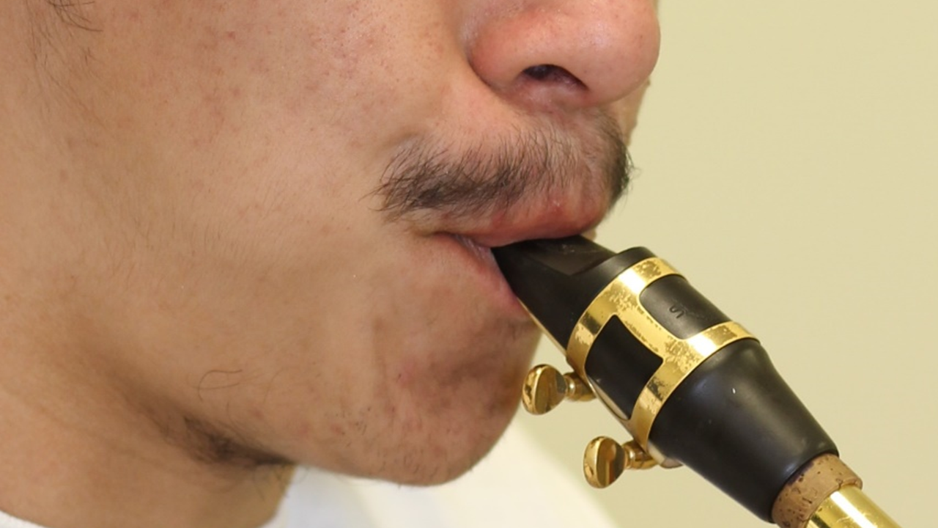

Slide 9
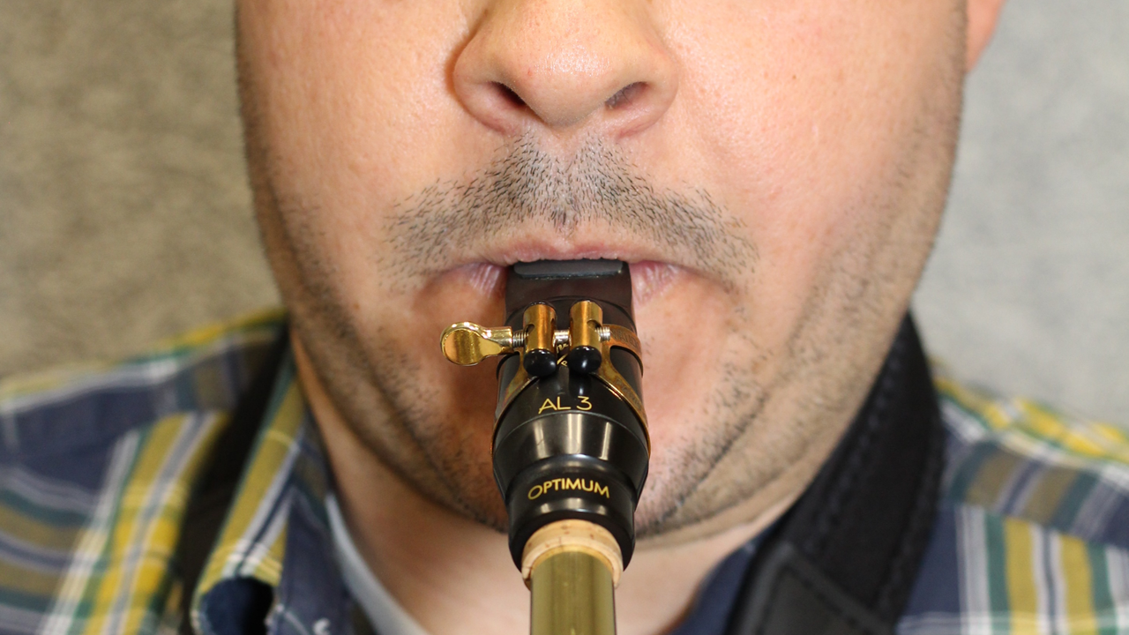
Vertical wrinkles in the lower lip
(like a drawstring bag)

Slide 10
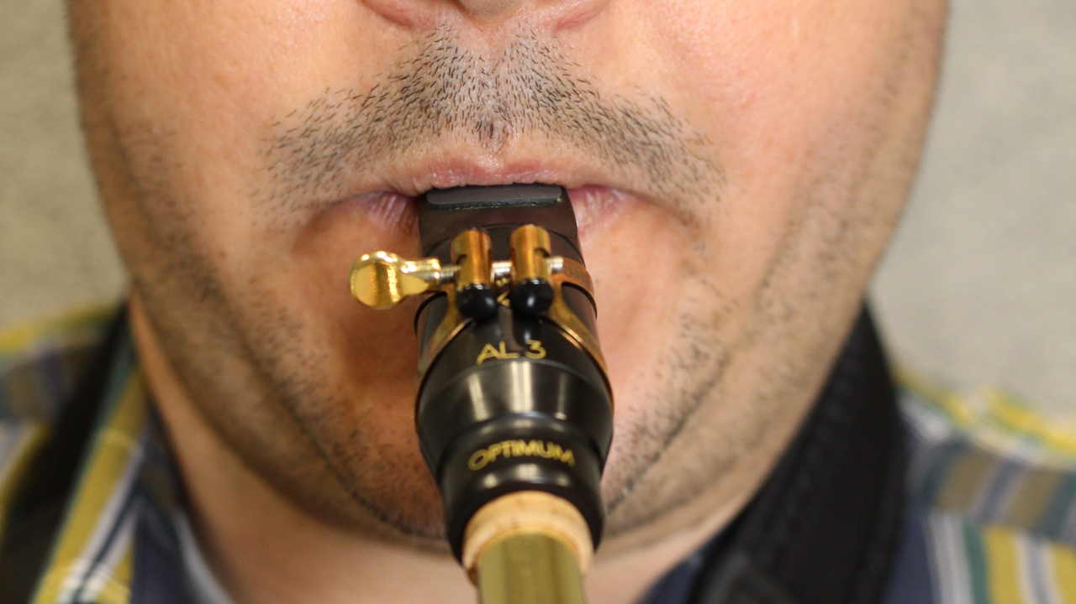

Slide 11
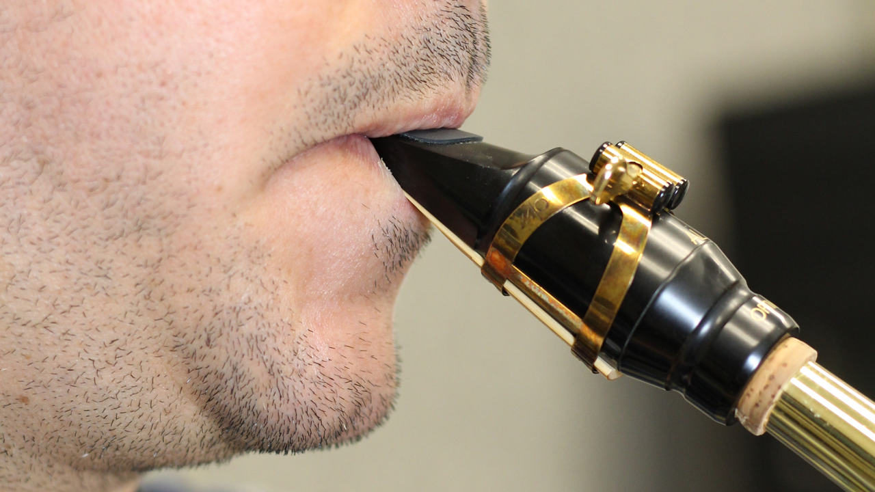
Natural chin (no bunching)

Slide 12
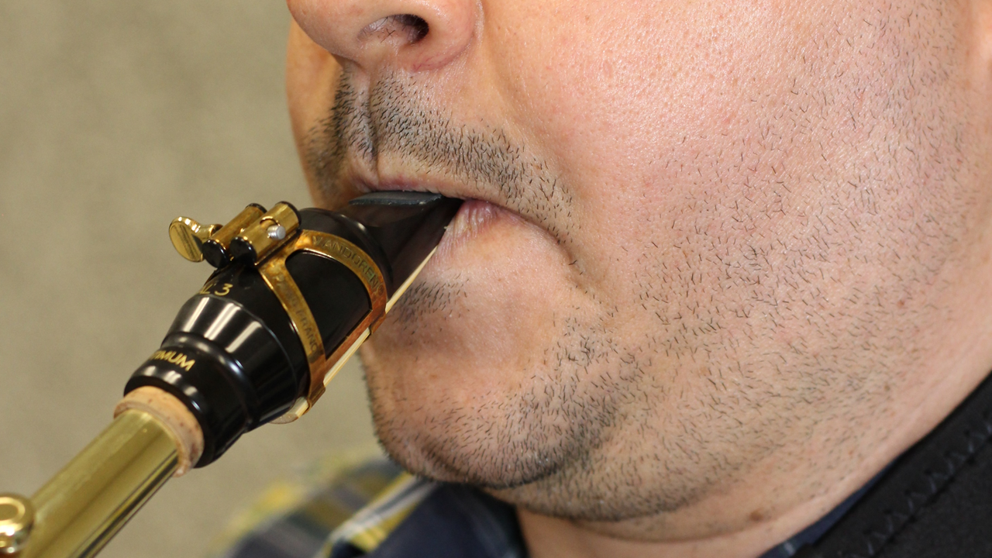
No air in cheeks

Slide 13
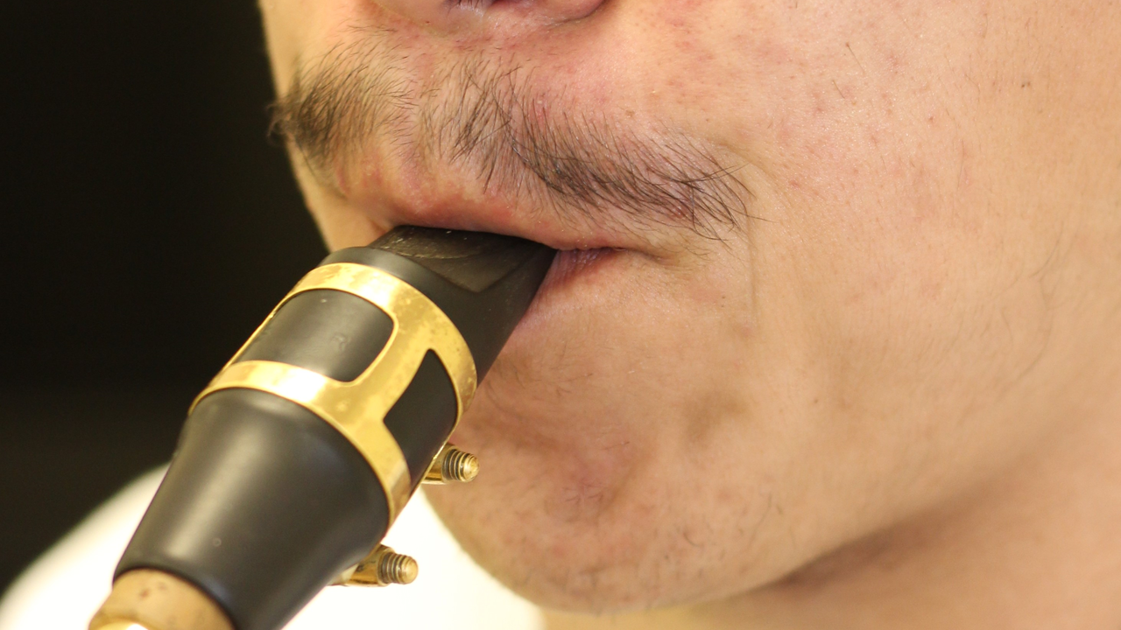

Slide 14
