Slide 1

Admiralsdon’tforget2240!

Slide 2
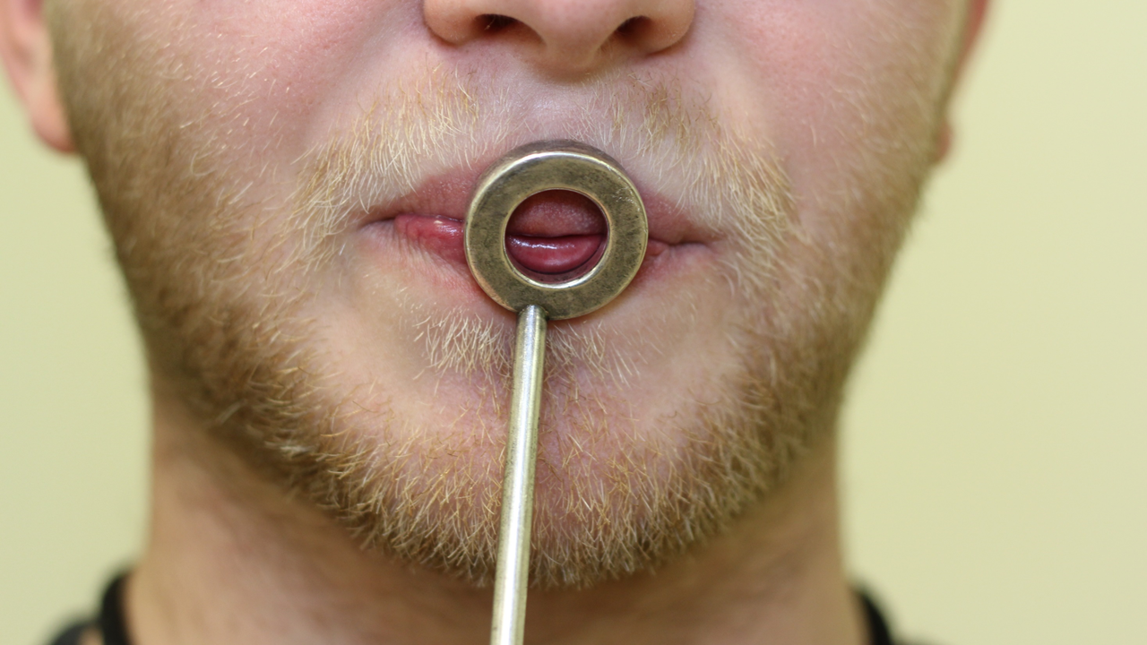
Mouthpiece centered over lips

Slide 3
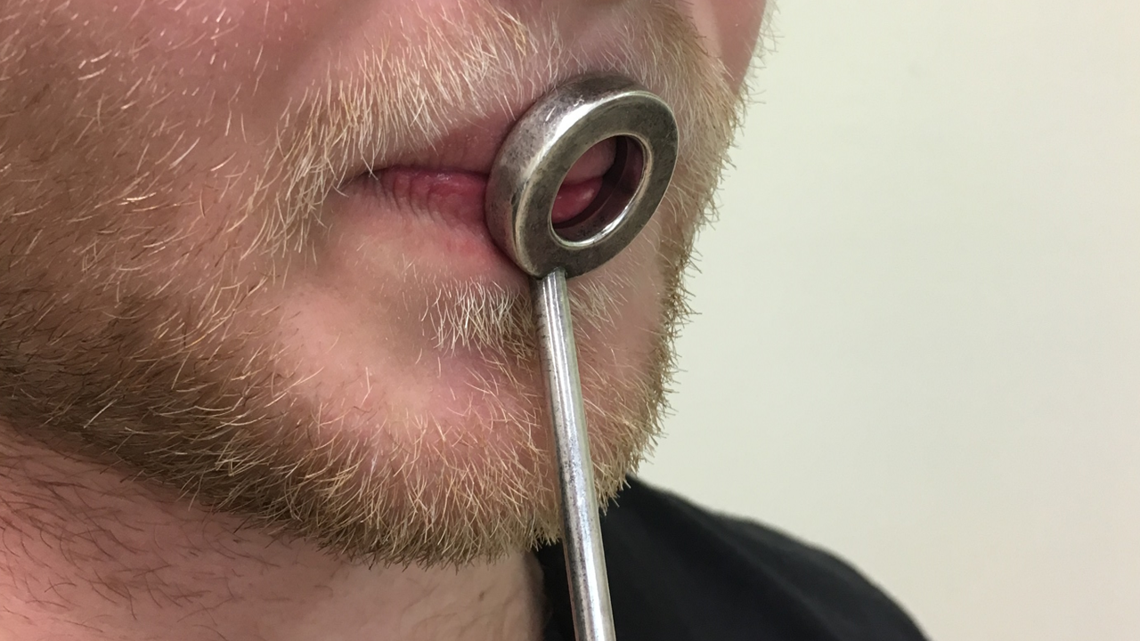
Lips and corners are firm

Slide 4
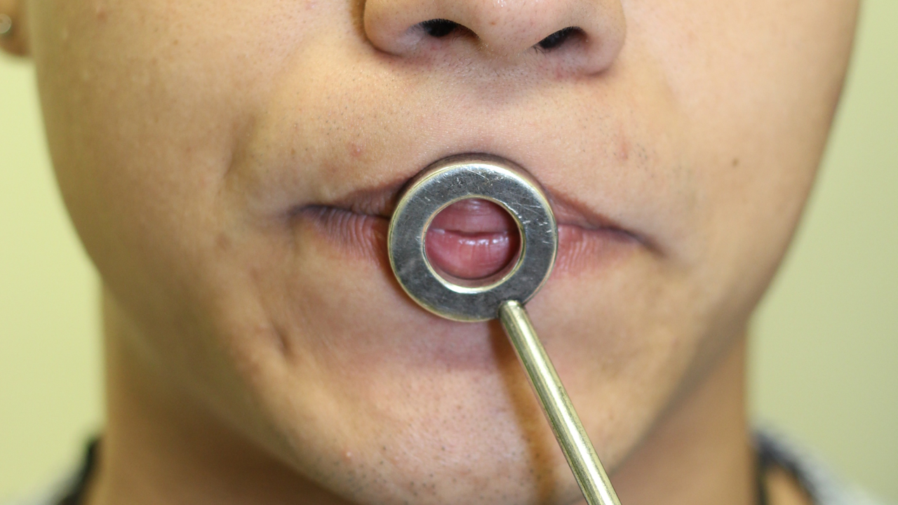

Slide 5
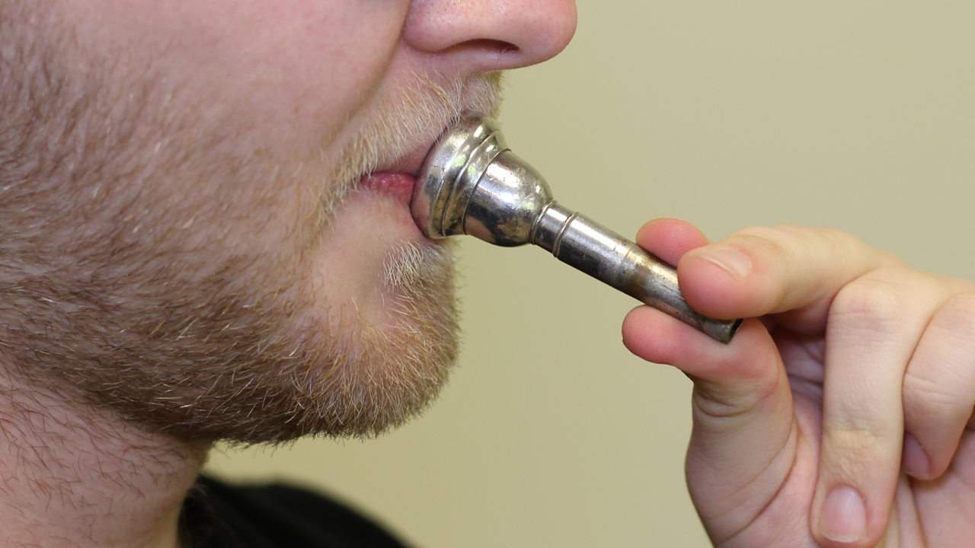

Slide 6
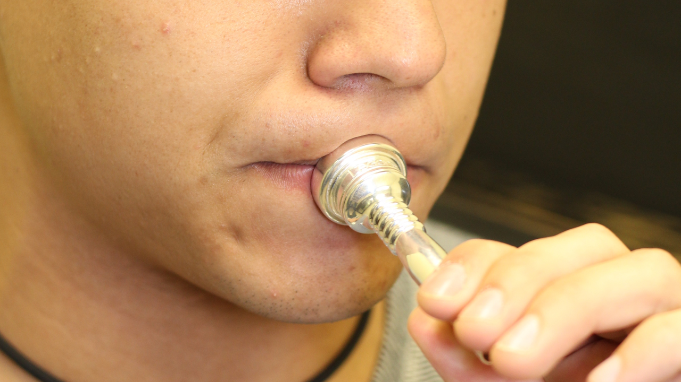
Flat, smooth chin (no bunching)

Slide 7
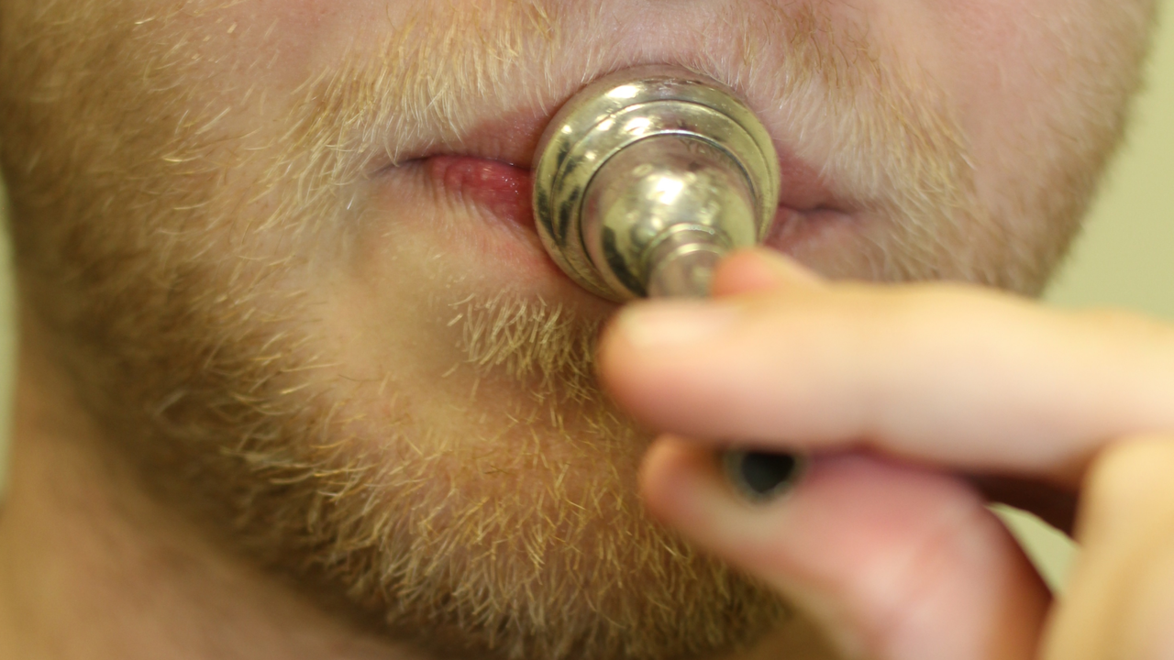

Slide 8
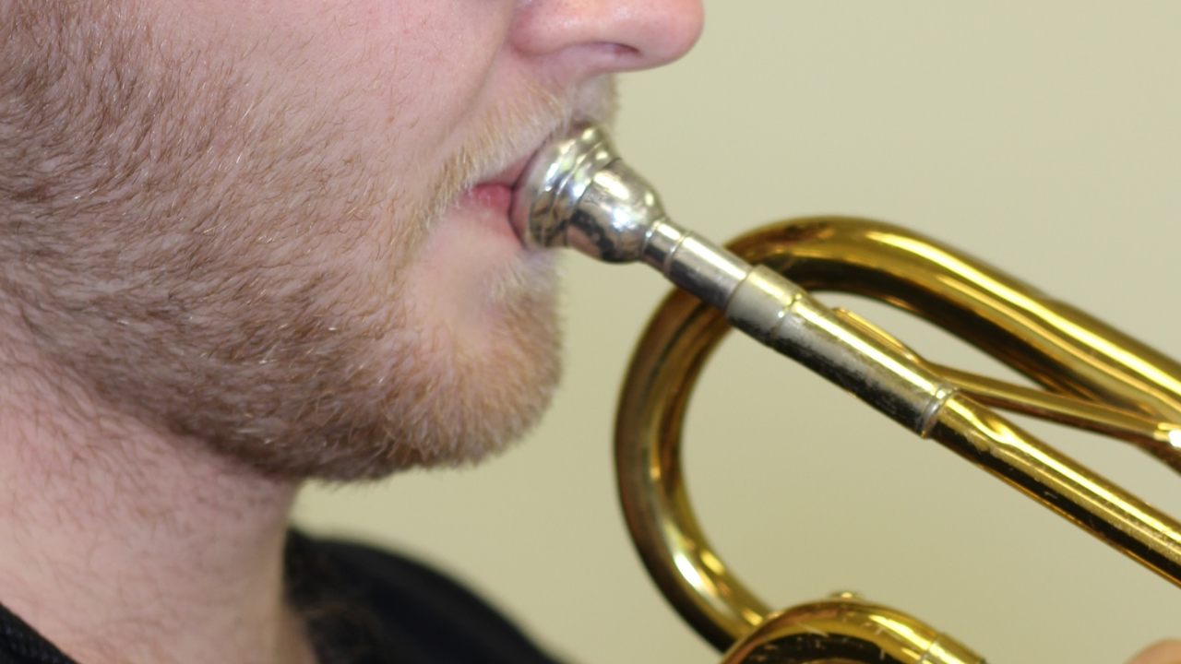
No air in cheeks

